Slide 2
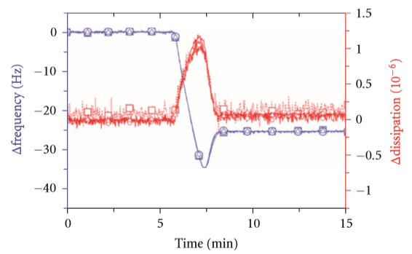

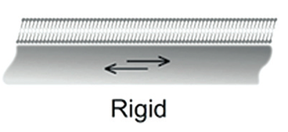

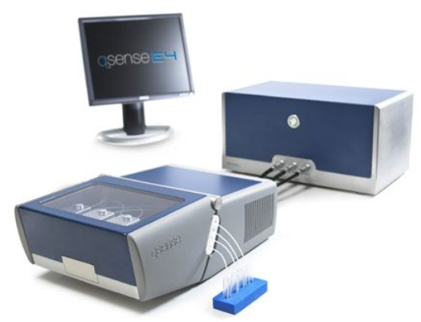
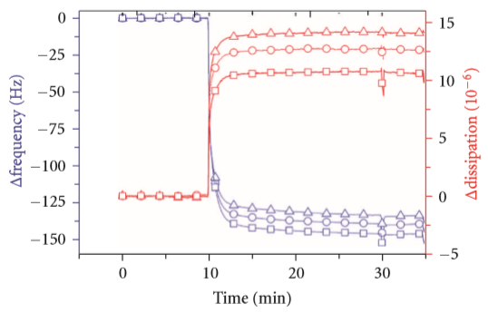
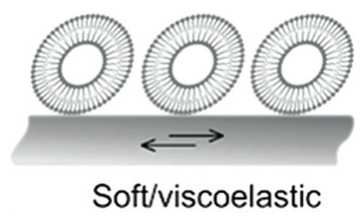
Quartz crystal microbalance and lipid membranes

Slide 3
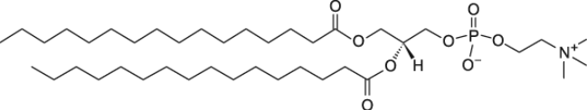
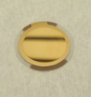
Experiment
DPPC T_{m} 41.5 °C
Au-coated quartz
Vesicles extruded with 100 nm pore membrane
Effect of hydrophobic chain length on melting temperature?
DPPC is 16:0, we will measure 15:0, 17:0 and I’ll provide you with data for 14:0

Slide 4
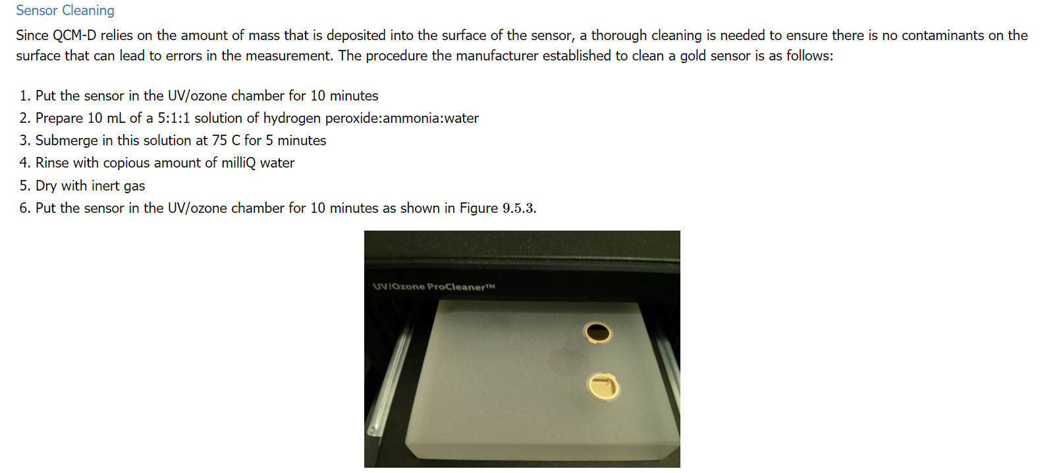
Step 1. Sensor cleaning
Task 1 to be included in the report: How does UV-ozone work?

Slide 5
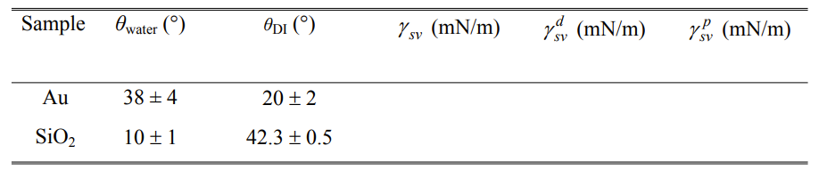
Step 2. Measure contact angle and calculate surface energy
Liquids: Water and diiodomethane
Task 2 to be included in the report: Calculate surface energy

Slide 6
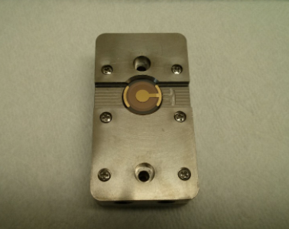
Step 3. Mount the QCM-D sensors in the QCM-D instrument

Slide 7
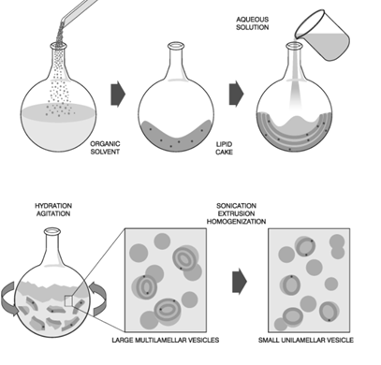
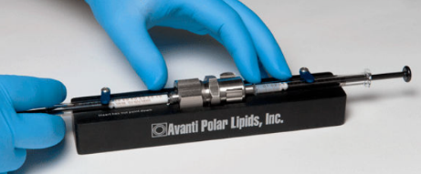
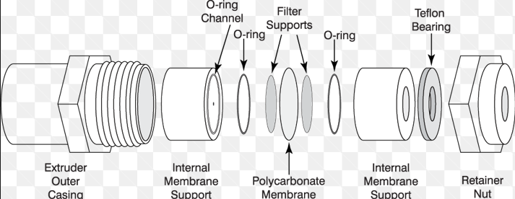
How to form lipid vesicles?
Lipid film formation:
Evaporation of solvent (clorophorm)
DPPC lipid
(T_{m} ~ -17 °C)
Lipid film hydration
With HEPES buffer
Extrusion

Slide 8
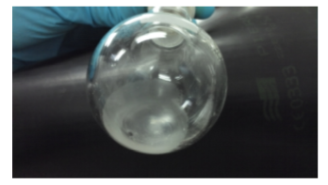
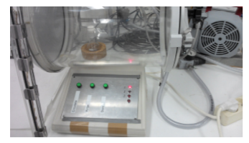
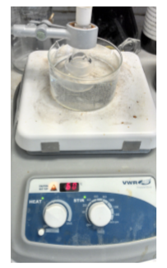
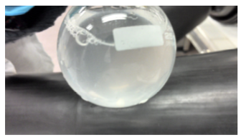
Step 4. Formation of vesicles
1) Dry lipid film
2) Overnight low pressure
4) Vortexing
3) Hydration

Slide 9
Step 5. Extrusion

Slide 10
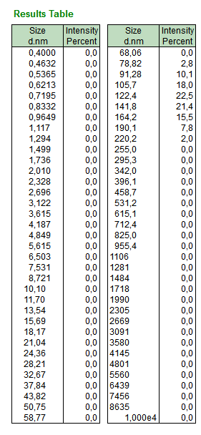
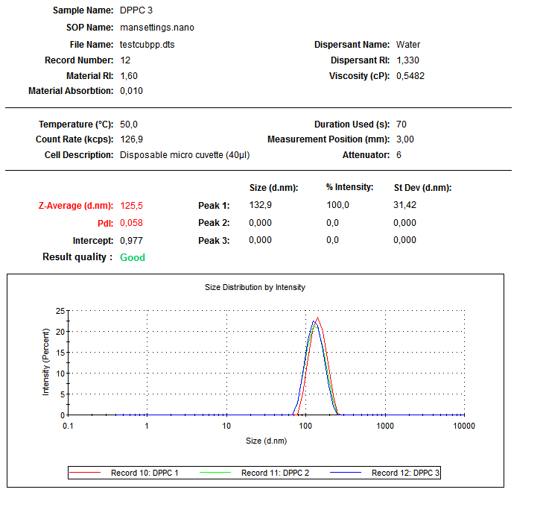
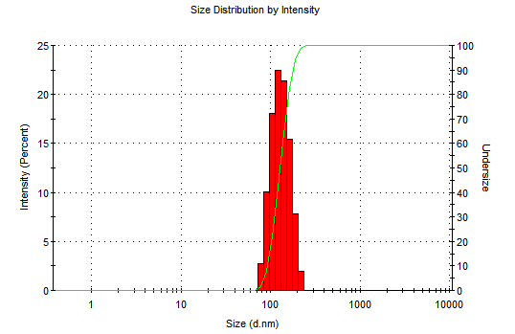
Step 6. DLS and zeta potential measurement
We will not do it this time since the instrument is busy

Slide 11
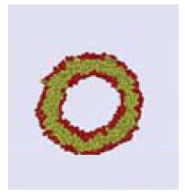
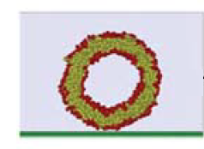
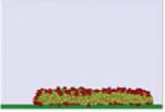
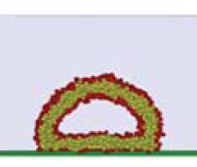
Vesicle adsorption process

Slide 12
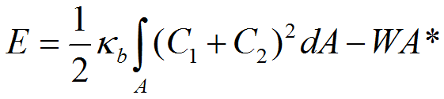
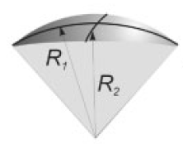
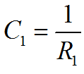
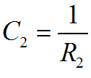

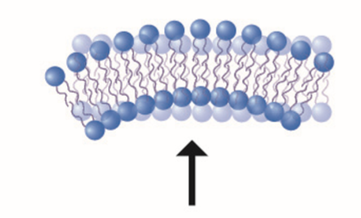
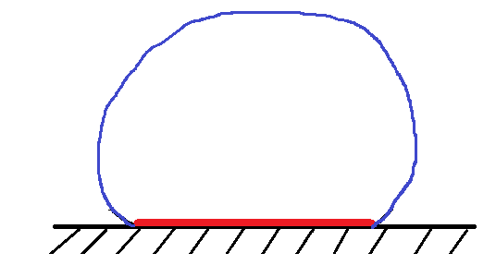

Vesicle adhesion
The shape of the adhered vesicle is determined by the interplay of adhesion and bending energies
Curvature
A_{free}
A*
W. Helfrich, Z. Naturforsch. 28c,693 (1973).
R. Lipowsky and U. Seifert, Mol. Cryst. Liq. Cryst. 202, 17 (1991)

Slide 13
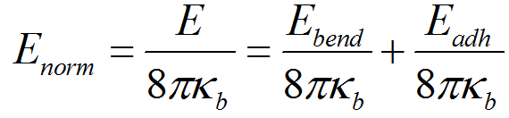

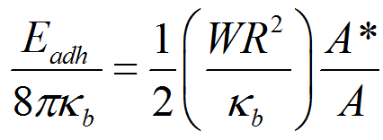
Vesicle adhesion
A_{free}
A*

Slide 14
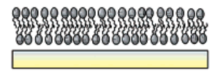
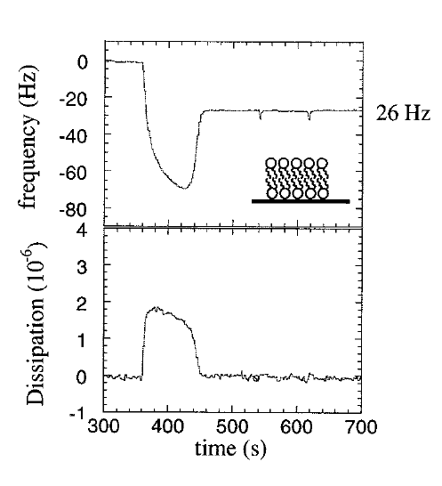
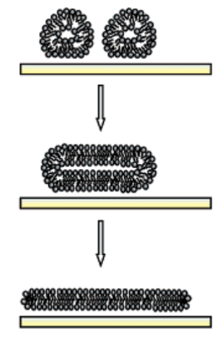
Strong adhesion
SiO₂
Adhesion favours vesicle fusion
C.A. Keller, Biophys. J. 75, 1397 (1998)

Slide 15
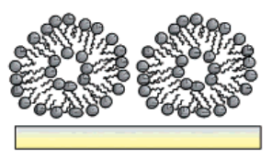
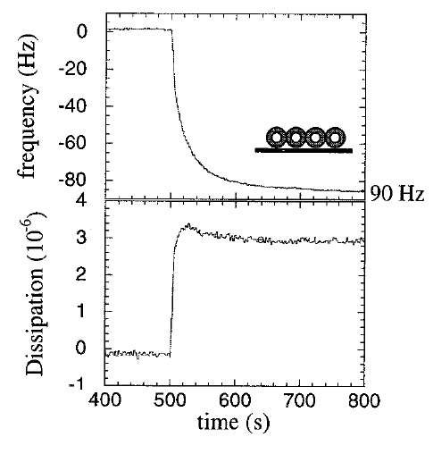
Weak adhesion
Au
No rupture, intact vesicle layer
C.A. Keller, Biophys. J. 75, 1397 (1998)

Slide 16
Task 3 to be included in the report: Plot Δf_{n} and ΔDn time dependence
and describe the adsorption process and layer formation

Slide 17
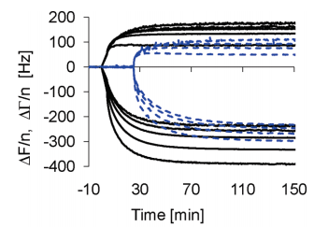
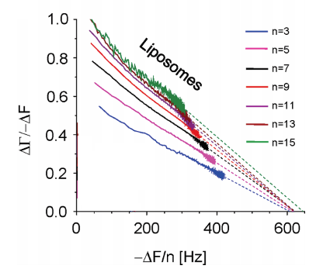
Task 4 to be included in the report: Plot −ΔD_{n}/Δf_{n} vs −Δf_{n} time dependence
and describe the adsorption process and layer formation
E. Tellechea, Langmuir 25, 5177 (2009)
Compare the size obtained with pore size to extrude vesicles in bulk

Slide 18
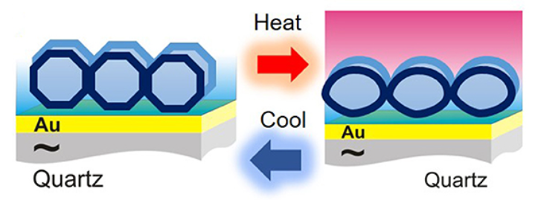
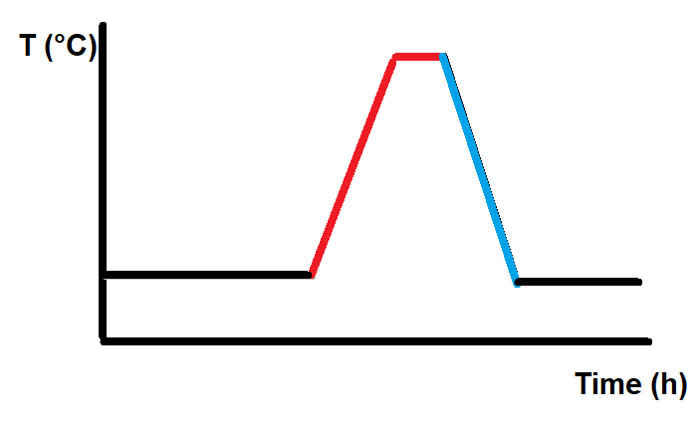
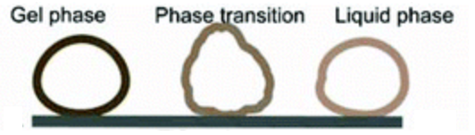
Monitoring lipid bilayer phase transitions
Neupane et al. Frontiers in Materials 5, 1096 (2018)

Slide 19
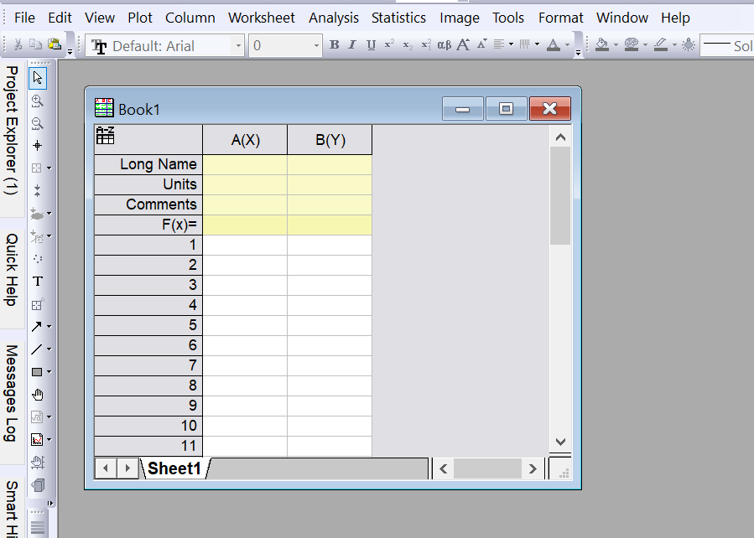
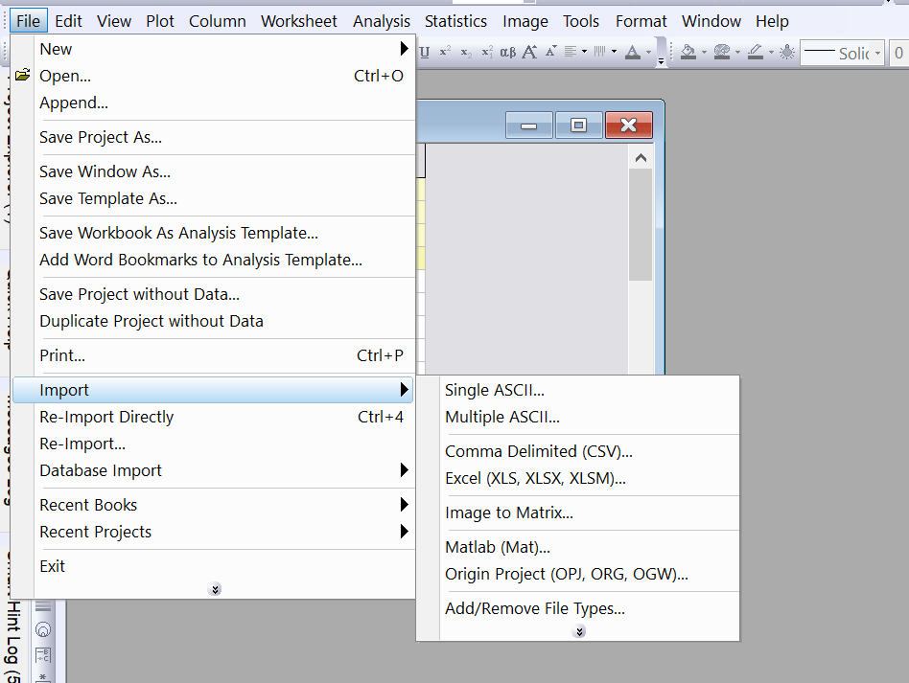
Analyzing the data

Slide 20
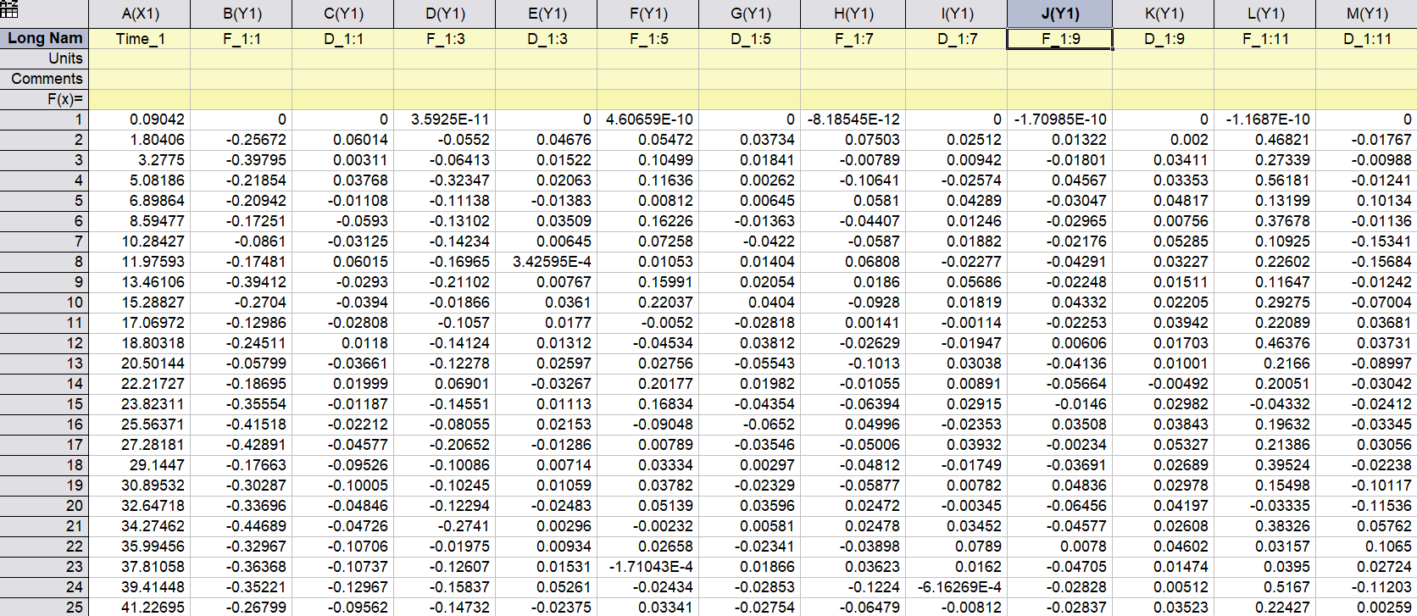
Analyzing the data
Overtone number
Sensor number
The fundamental overtone is very unstable, start from the 3rd

Slide 21
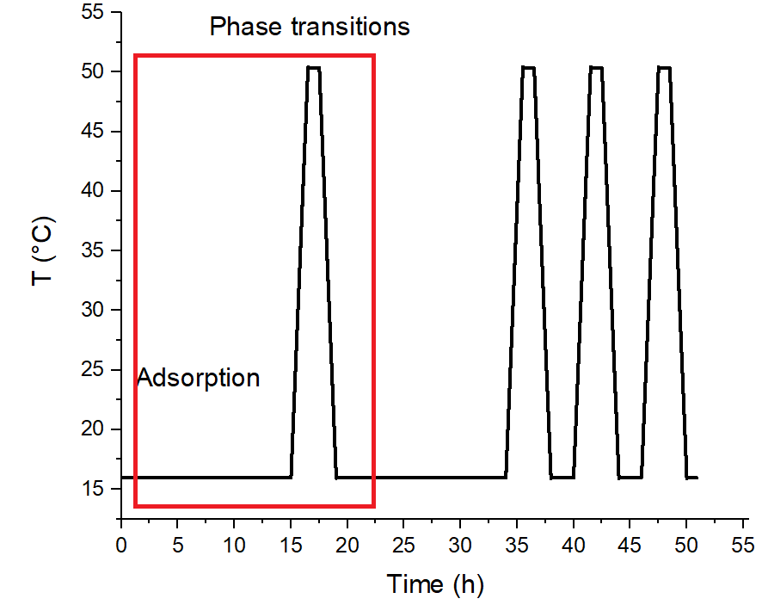
Overall experiment

Slide 22
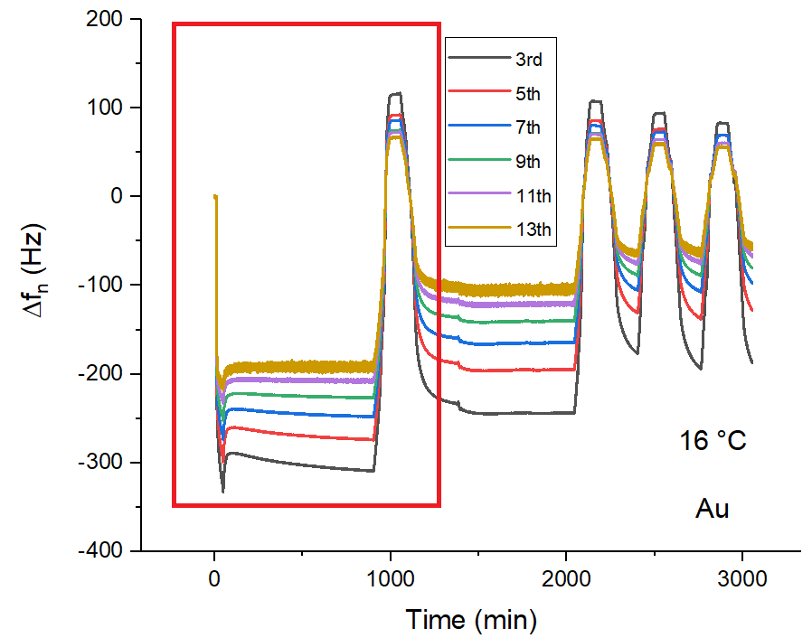
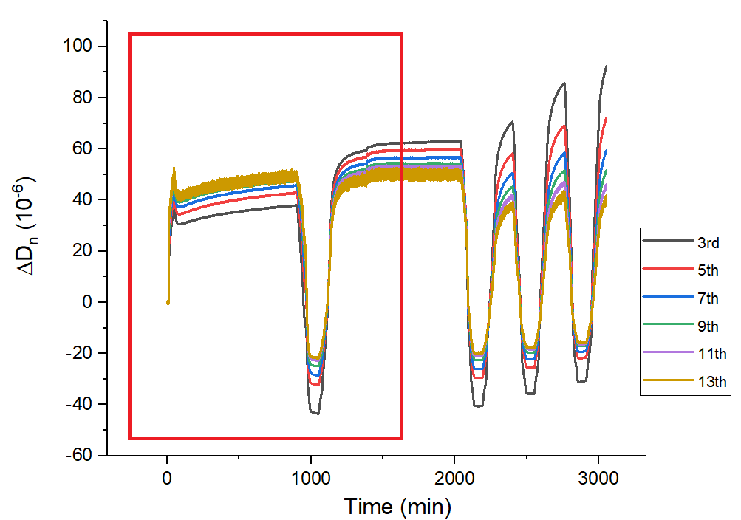
Overall experiment

Slide 23
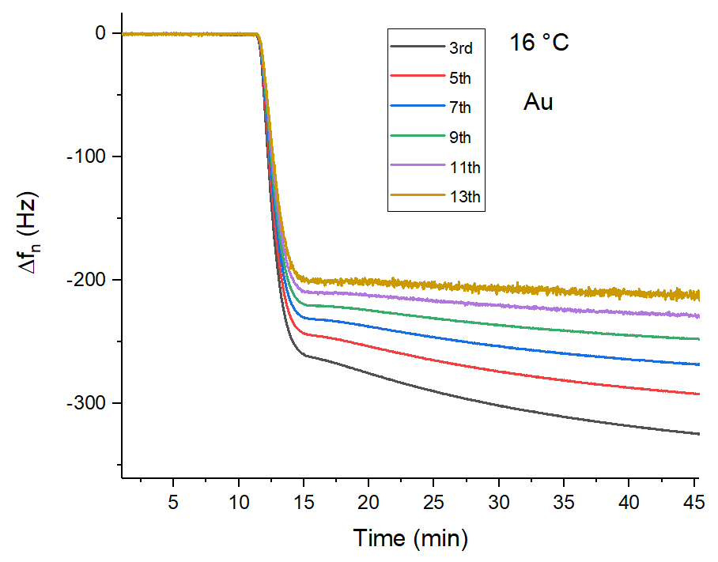
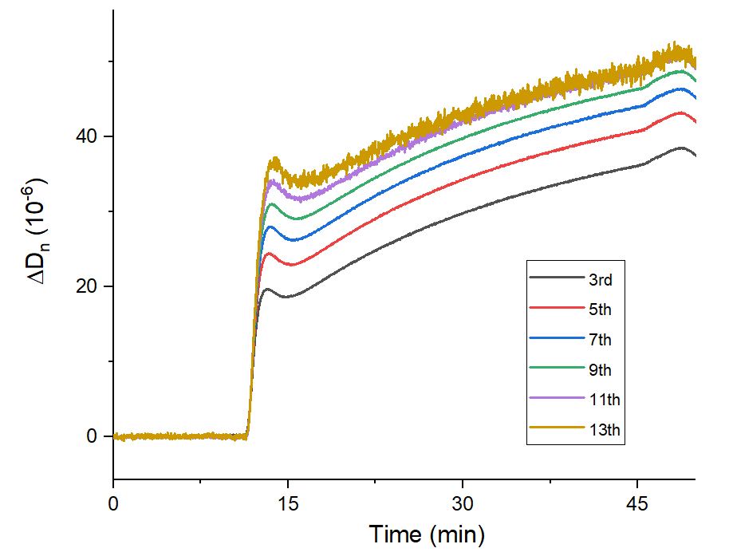
Initial adsorption

Slide 24
Layer thickness estimation
Plot −ΔD_{n}/Δf_{n} vs −Δf_{n} time dependence
E. Tellechea, Langmuir 25, 5177 (2009)

Slide 25




Slide 26




